Slide 1
Framing, HDLC and PPP
Dr. R. Prashanth

Slide 2
Introduction
In the physical layer, data transmission involves synchronised transmission of bits from the source to the destination. The data link layer packs these bits into frames.
Data-link layer takes the packets from the Network Layer and encapsulates them into frames. If the frame size becomes too large, then the packet may be divided into small sized frames.
Smaller sized frames makes flow control and error control more efficient.
Frames are the units of digital transmission, particularly in computer networks and telecommunications.

Slide 3
Framing is a point-to-point connection between two computers or devices consisting of a wire in which data is transmitted as a stream of bits.
However, these bits must be framed into discernible blocks of information. Framing is a function of the data link layer. It provides a way for a sender to transmit a set of bits that are meaningful to the receiver.
Ethernet, token ring, frame relay, and other data link layer technologies have their own frame structures. Frames have headers that contain information such as error-checking codes.
The data link layer needs to pack bits into frames, so that each frame is distinguishable from another.
Our postal system practices a type of framing. The simple act of inserting a letter into an envelope separates one piece of information from another; the envelope serves as the delimiter.

Slide 4
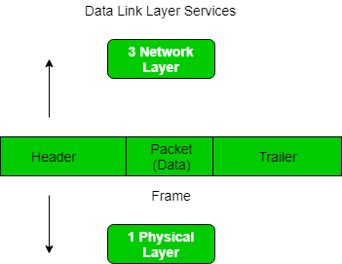

Slide 5
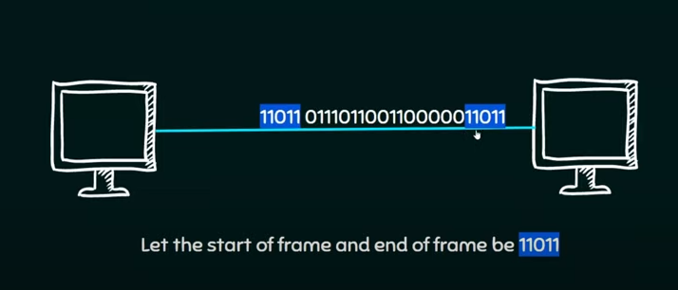
Example

Slide 6
Part of a Frame
Header: It consists of the frame's source and destination address. A frame header holds the destination address, the supply address, and 3 management fields kind, seq, and ack helping the subsequent purposes:
kind: This field expresses whether the frame could be an information frame, or it's used for management functions like error and flow management or link management, etc.
Seq: This holds the sequence variation of the frame for transcription of out–of–sequence frames and causing acknowledgments by the receiver.
Ack: This contains the acknowledgment variety of some frames, significantly once piggybacking is employed.

Slide 7
Payload: It contains the message to be delivered. It contains the particular message or data that the sender desires to transmit to the destination machine. It contains the particular message or data that the sender desires to transmit to the destination machine
Trailer: It contains the error detection and correction bits.
Flag: It contains the points to the starting and the ending of the frame.

Slide 8
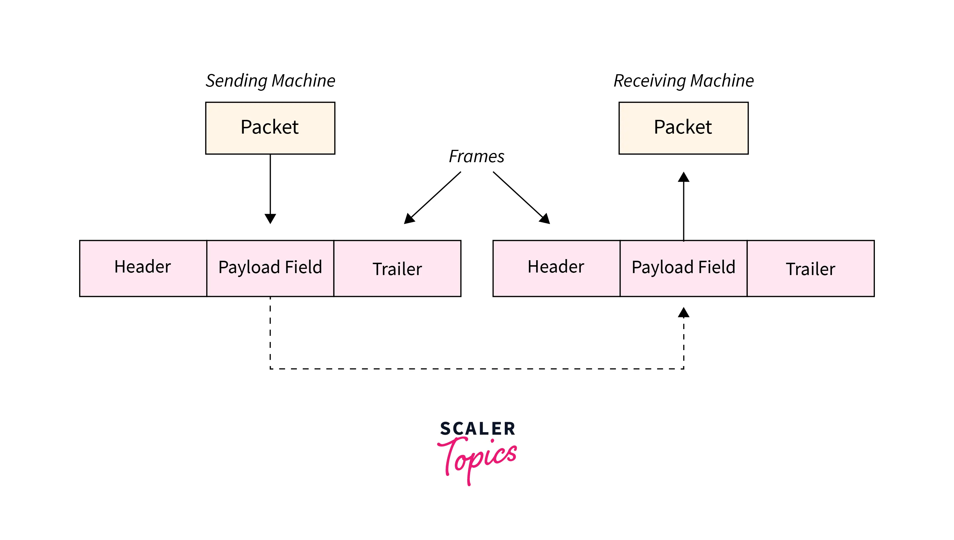

Slide 9
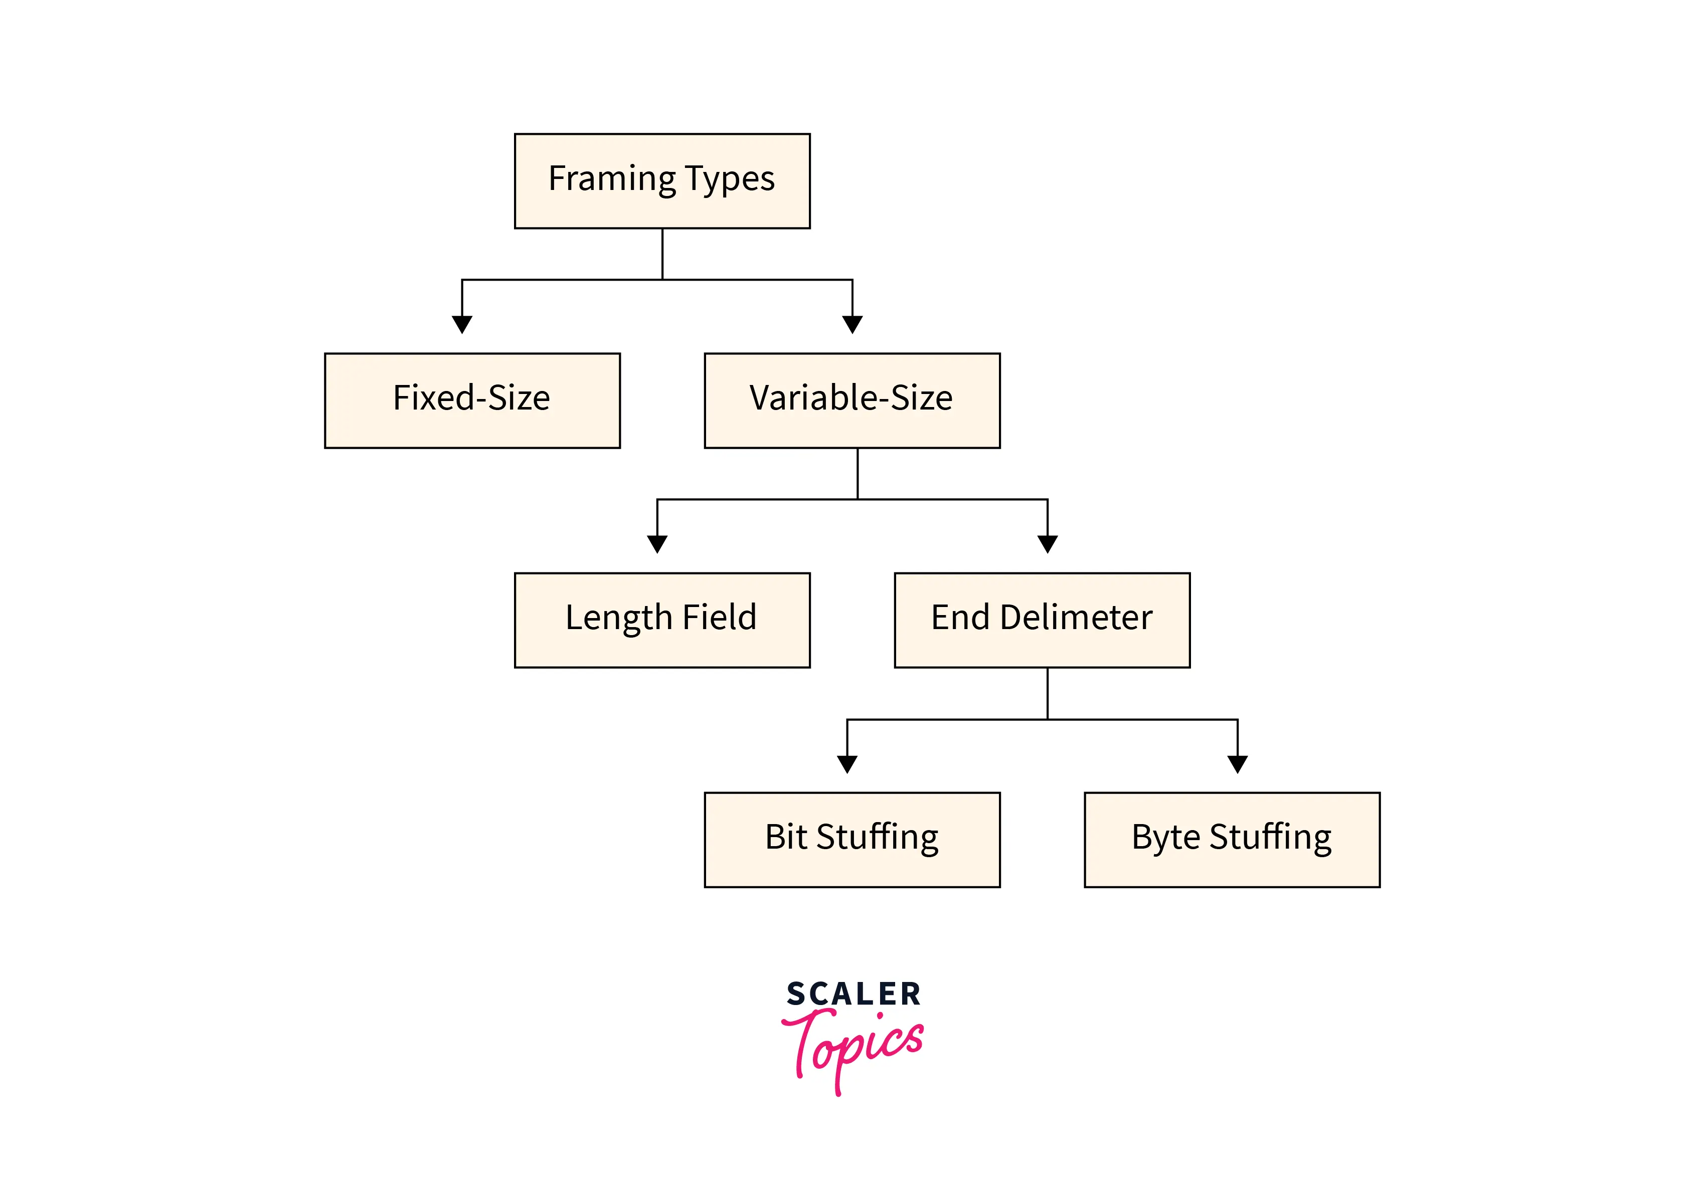
Types of Frames
There are two types of framing in the data link layer. The frame can be of fastened or variable size. founded on the size, the following are the types of framing in data link layers in computer networks.

Slide 10
Fixed Size Framing
In this Fixed-size framing, the size of the frame is always fixed that's why frame length acts as the delimiter of the frame.
And it also doesn't require additional boundaries to identify the start and end of the frame.
For example- This kind of framing in the Data Link Layer is used in ATMs, Wide area networks(WAN). They use frames of fastened size known as cells.

Slide 11
Variable Size Framing
The size of the frame is variable during this form of framing. In variable-size framing, we are in need of a way to outline the tip of the frame and also the starting of the succeeding frame. This can be utilized in local area networks(LAN).
There are 2 different methods to define the frame boundaries, such as length field and finish decimeters.
Length field–To confirm the length of the field, a length field is used. It is utilized in Ethernet (1EEE 802.3).
End Delimeter–To confirm the size of the frame, a pattern is worn as a delimiter. This methodology is worn in the token ring. In short, it is referred to as ED. Two different methods are used to avoid this condition if the pattern happens within the message. Character Oriented Approach Bit Oriented Approach

Slide 12
Talking about Framing Approaches in computer networking, there is mainly the 2-different kind of approaches to Framing in the Data link layer:
1. Bit-Oriented Framing
Most protocols use a special 8-bit pattern flag 01111110 as a result of the delimiter to stipulate the beginning and so the end of the frame. Bit stuffing is completed at the sender end and bit removal at the receiver end.
Best example is HDLC

Slide 13
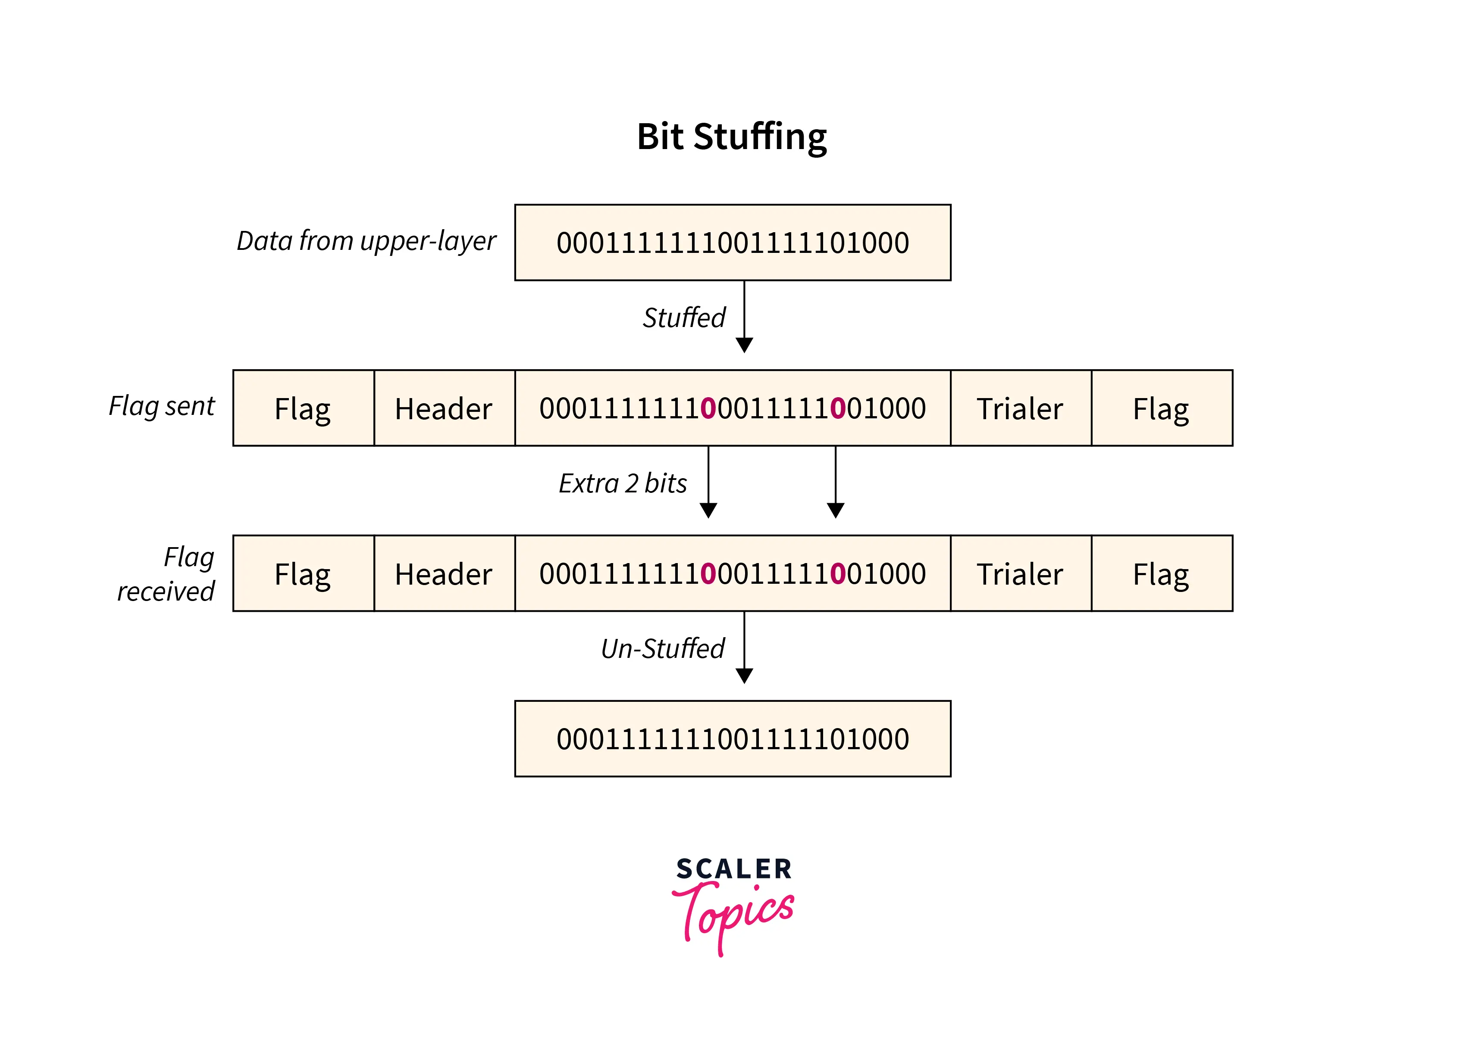

Slide 14
2. Byte-Oriented Framing
Byte stuffing is one of the methods of adding an additional byte once there is a flag or escape character within the text. Take an illustration of byte stuffing as appeared in the given diagram.
The sender sends the frame by adding three additional ESC bits and therefore the destination machine receives the frame and it removes the extra bits to convert the frame into an identical message.
Best example is point-to-point protocol

Slide 15
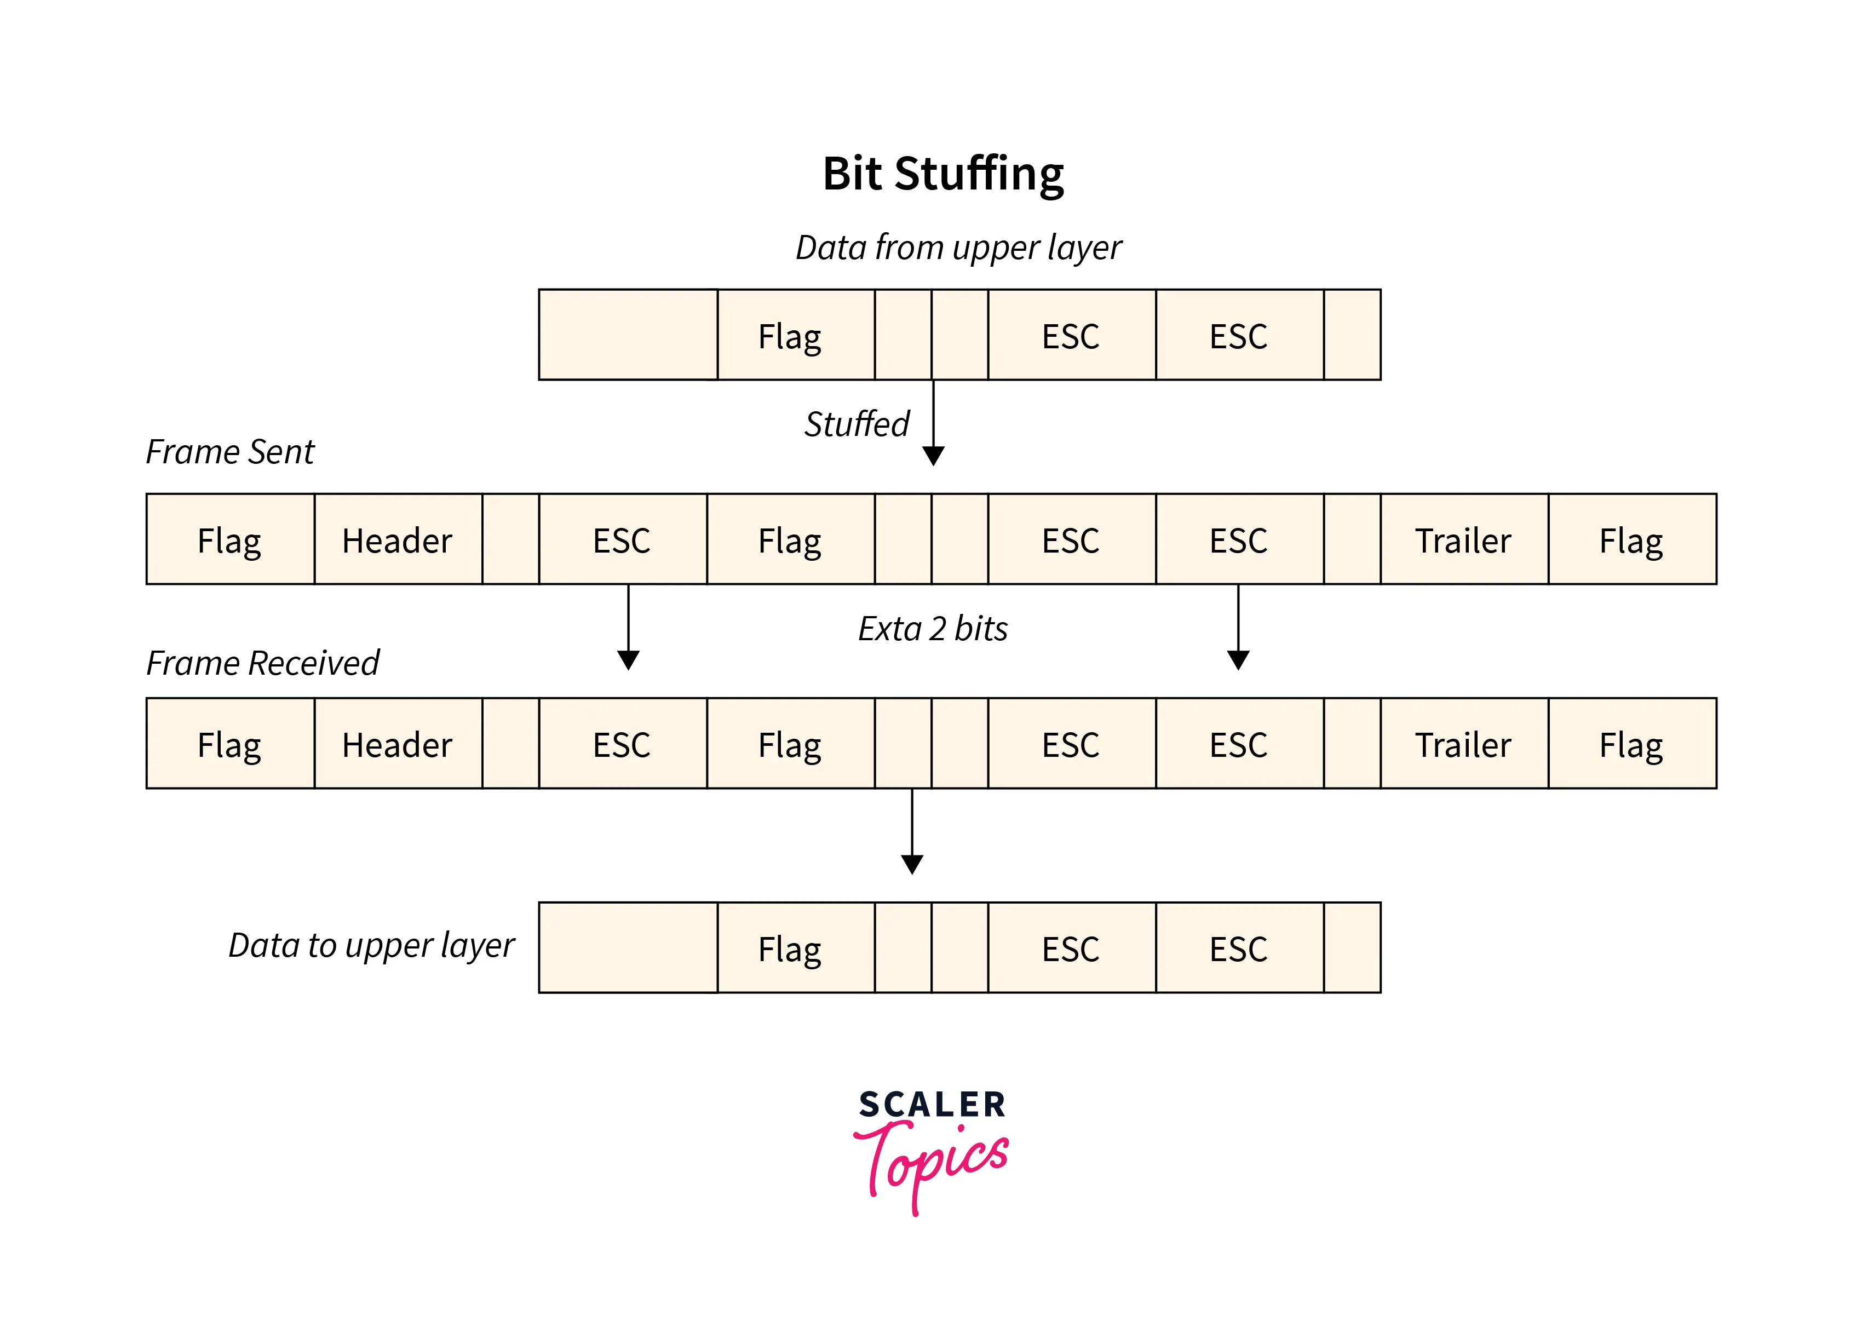

Slide 16
High-level Data Link Control (HDLC)
HDLC (High-level Data Link Control) is a group of protocols or rules for transmitting data between network points (sometimes called nodes).
The Synchronous Data Link Control (SDLC) protocol developed by IBM is an example of a bit-oriented protocol.
Later, SDLC standardized by the ISO as the HDLC protocol.
A frame is transmitted via the network to the destination that verifies its successful arrival. It is a bit - oriented protocol that is applicable for both point - to - point and multipoint communications.

Slide 17
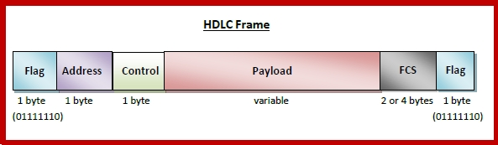
HDLC Frame

Slide 18
HDLC is a bit - oriented protocol where each frame contains up to six fields. The structure varies according to the type of frame. The fields of a HDLC frame are −
Flag − It is an 8-bit sequence that marks the beginning and the end of the frame. The bit pattern of the flag is 01111110.
Address − It contains the address of the receiver. If the frame is sent by the primary station, it contains the address(es) of the secondary station(s). If it is sent by the secondary station, it contains the address of the primary station. The address field may be from 1 byte to several bytes.
Control − It is 1 or 2 bytes containing flow and error control information.
Payload − This carries the data from the network layer. Its length may vary from one network to another.
FCS (CRC) − It is a 2 byte or 4 bytes frame check sequence for error detection. The standard code used is CRC (cyclic redundancy code)

Slide 19
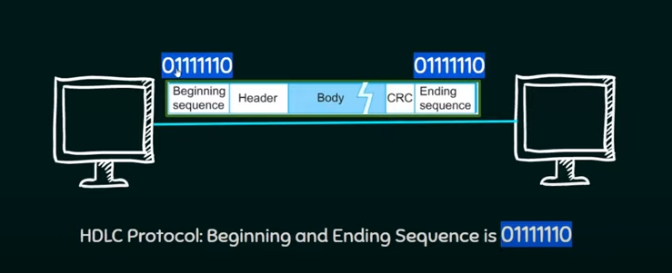

Slide 20
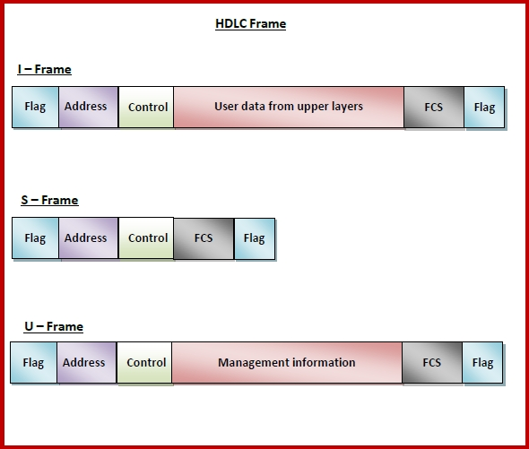
Types of HDLC Frames

Slide 21
There are three types of HDLC frames. The type of frame is determined by the control field of the frame −
I-frame − I-frames or Information frames carry user data from the network layer. They also include flow and error control information that is piggybacked on user data. The first bit of control field of I-frame is 0.
S-frame − S-frames or Supervisory frames do not contain information field. They are used for flow and error control when piggybacking is not required. The first two bits of control field of S-frame is 10.
U-frame − U-frames or Un-numbered frames are used for myriad miscellaneous functions, like link management. It may contain an information field, if required. The first two bits of control field of U-frame is 11.

Slide 22
Point-to-Point Protocol (PPP)
Point - to - Point Protocol (PPP) is a communication protocol of the data link layer that is used to transmit multiprotocol data between two directly connected (point-to-point) computers.
It is a byte - oriented protocol that is widely used in broadband communications having heavy loads and high speeds.
Since it is a data link layer protocol, data is transmitted in frames. It is also known as RFC 1661.

Slide 23
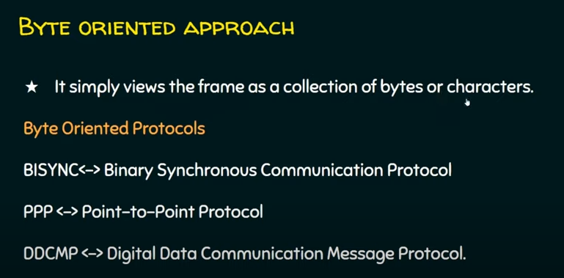

Slide 24
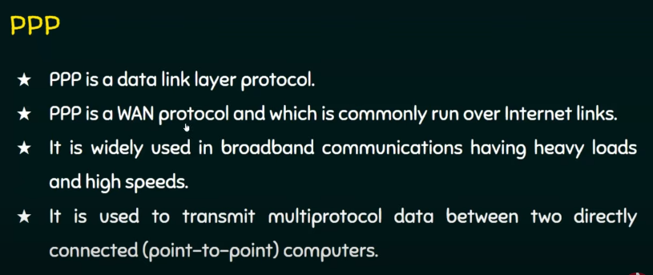

Slide 25
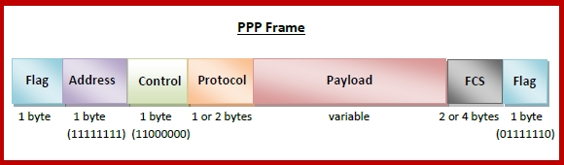
PPP Frame

Slide 26
PPP is a byte - oriented protocol where each field of the frame is composed of one or more bytes. The fields of a PPP frame are −
Flag − 1 byte that marks the beginning and the end of the frame. The bit pattern of the flag is 01111110.
Address − 1 byte which is set to 11111111 in case of broadcast.
Control − 1 byte set to a constant value of 11000000.
Protocol − 1 or 2 bytes that define the type of data contained in the payload field.
Payload − This carries the data from the network layer. The maximum length of the payload field is 1500 bytes. However, this may be negotiated between the endpoints of communication.
FCS − It is a 2 byte or 4 bytes frame check sequence for error detection. The standard code used is CRC (cyclic redundancy code)

Slide 27
Byte Stuffing in PPP Frame − Byte stuffing is used is PPP payload field whenever the flag sequence appears in the message, so that the receiver does not consider it as the end of the frame.
The escape byte, 01111101, is stuffed before every byte that contains the same byte as the flag byte or the escape byte.
The receiver on receiving the message removes the escape byte before passing it onto the network layer.

